Slide 1
BCOG 100
Spatial Cognition
Lecture 1: Maps in the Mind

Slide 2
Reading Check 8-1
Password: space
Question: What’s the difference between egocentric and allocentric coding, and which one do human babies have first?

Slide 3
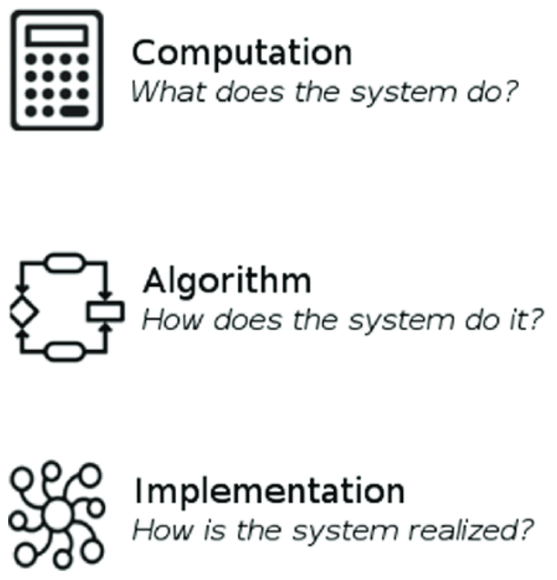
Spatial Cognition
Recap & Overview
Hebbian learning, Reinforcement Learning, and Pattern Recognition made vertebrates pretty smart.
Today:
The next challenge—stability, structure, and exploration
Computational/Functional Level View
Notes:
Last time we explored how reinforcement learning allowed organisms to connect actions and outcomes across time.
That ability built on earlier evolutionary layers: reflexes that guided simple approach-avoidance, Hebbian learning that stabilized useful associations, and pattern recognition that allowed generalization across similar situations.
Together these systems let organisms learn from experience and adapt to change, but only within familiar contexts.
At this point in evolution, animals could react intelligently, learn what worked, and even chain actions toward distant rewards.
But they still lacked something crucial—a way to keep behavior stable as they moved, to organize what they learned into a coherent structure of relationships, and to explore effectively when feedback was scarce.
Today we turn to the next major problem brains had to solve: how to maintain orientation, track movement, and represent the world well enough to plan within it.
This marks the transition from learning about values in time to learning about relations in space—the functional foundation of spatial cognition.
By the end of this lecture, you should have a sense of how each earlier capability prepared the ground, and why solving these new problems required a qualitatively different kind of system.

Slide 4
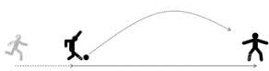
Spatial Cognition
Problem 1: The Problem of Self-Motion and Perceptual Stability
When we move, the world seems to move too
Our brains must keep perception stable amid constant change
The same problem faced early vertebrates
Notes:
Imagine driving down a curving road at night.
As you turn the wheel, trees and headlights sweep across your field of view, yet the world doesn’t feel like it’s spinning—you feel like you’re turning.
Your brain instantly discounts the visual motion you caused and keeps the scene stable enough to steer safely.
If that compensation slips—say when you glance sideways or hit an icy patch—the world suddenly seems to lurch, and orientation is momentarily lost.
That fleeting disorientation illustrates a deep computational problem.
Every movement we make changes the sensory stream: light patterns shift, sounds warp, pressure on the skin redistributes.
Without a mechanism to track how our own actions alter these signals, the brain would misinterpret self-generated change as change in the world itself.
Humans solve this so automatically that it feels effortless.
When we accelerate, we expect the scenery to slide backward; when we brake, we expect it to surge forward.
The nervous system predicts and subtracts those effects in real time.
Early vertebrates faced the same challenge in a simpler form.
Each flick of a fin changed what they saw and felt, threatening to destabilize orientation.
Evolution gradually added systems that integrate motion signals from eyes, body, and inner sensors—allowing behavior to remain coordinated even as sensory input constantly shifts.
This ability to stabilize perception during movement laid the groundwork for later, more explicit spatial representations.

Slide 5
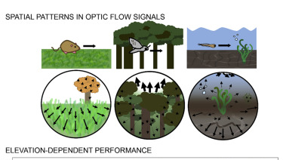
Spatial Cognition
Early Vertebrate Solutions to the Stability Problem
Fish integrate multiple motion cues to stay oriented
Vision, balance, and body feedback work together
These systems evolved to keep perception stable during movement
Notes:
Now imagine how this challenge looks for a small fish in moving water.
Every flick of its tail changes both what it sees and what it feels.
Waves distort light, currents push its body, and nearby rocks slide across its field of view.
If the fish treated all those sensory changes as movement in the world,
it would lose track of direction within seconds.
Many fish solve this through a remarkable kind of sensory coordination.
They integrate signals from several systems at once:
— vision, which detects optic flow as the background moves across the eyes;
— the vestibular system, which senses acceleration and tilt;
— and proprioceptive feedback from muscles and fins.
Together these inputs allow the fish to infer when the change it’s sensing
is due to its own motion versus an external disturbance.
Some species even stabilize their gaze while the rest of the body moves
—rotating the eyes in the opposite direction of head motion to keep the world visually steady.
Others use the flow of water along their lateral line to detect self-generated movement,
automatically adjusting swimming patterns to stay balanced.
These are still low-level control systems, not yet cognitive maps.
But they show that the roots of spatial cognition lie in the need for perceptual constancy during motion.
Once animals could predict the sensory consequences of their own actions,
they could begin to treat movement as structured and predictable
—a first step toward representing space itself.

Slide 6
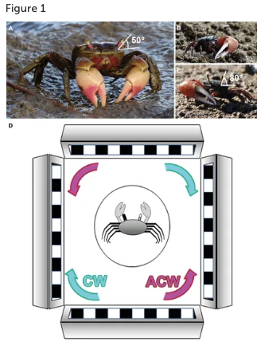
Spatial Cognition
Non-Vertebrate Comparisons
Many invertebrates can’t separate self-motion from world-motion
Orientation depends on external cues or pauses in movement
Vertebrates evolved internal mechanisms for stability
Notes:
To appreciate how special those vertebrate systems are, it helps to look at organisms that don’t have them.
Consider small crustaceans or worms that move by rhythmic undulations or ciliary gliding.
When these animals turn or change speed, their sensory world changes drastically,
and they often treat that change as if the environment itself has shifted.
They can become disoriented or even stop moving until stable external cues reappear.
Experiments with certain crustaceans show that when the surrounding visual scene is rotated,
they will rotate their bodies to keep the image steady—essentially chasing the moving background rather than compensating for it.
Without integrated feedback from balance or motion sensors, they can’t tell whether the apparent movement is self-generated or external.
Many invertebrates re-establish orientation only after halting movement and re-sampling the environment.
That pause is their way of rebooting perception
—an external, behavioral fix rather than an internal computational one.
Vertebrates, by contrast, can maintain a continuous sense of stability while moving,
because their nervous systems predict how self-motion should affect sensory input.
This marks a key evolutionary boundary.
Before these integration systems evolved, perception and action could only be linked through reactive feedback.
With them, movement and perception become coordinated in real time,
setting the stage for the next major innovation:
bthe ability to estimate not just that one has moved,
but how far and in what direction.

Slide 7
Spatial Cognition
Problem 1 : Summary & Key Terms
Challenge: movement changes sensory input
Goal: maintain perceptual stability during motion
Key terms: optic flow, vestibular input, proprioception, efference copy
Notes:
Let’s pause and summarize what this first problem was about.
The challenge is that every movement an organism makes changes its entire sensory field.
If it can’t tell which changes come from its own motion, behavior quickly becomes unstable.
Early vertebrates developed ways to compensate.
They used optic flow —the pattern of visual motion across the eyes—to estimate direction and speed.
They added vestibular input from balance organs that sense acceleration and tilt.
And they relied on proprioception, internal feedback from muscles and joints that signals how the body is positioned.
Together, these systems allow an animal to subtract out the effects of its own movement and keep the world perceptually steady.
A related idea you’ll hear in neuroscience is the efference copy: when the brain sends a motor command, it also sends a duplicate to sensory areas predicting the expected sensory change.
That prediction lets perception stay stable even as the body moves.
So the solution to this first problem wasn’t yet a map of space—it was a way to stabilize experience in a moving body.
Once organisms could do that, the next step was to estimate not only that they had moved, but how far and in what direction—the foundation of navigation itself.

Slide 8
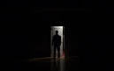
Spatial Cognition
Problem 2 : Tracking Position Without Landmarks
How do we know where we are when we can’t see?
Navigation often depends on internal cues, not external signals
Humans, like other animals, can estimate movement through unseen space
Notes:
Imagine getting out of bed at night and walking to the door in a dark room.
You can’t see the furniture or the walls, but you still move roughly in the right direction.
You might brush the doorframe instead of hitting it perfectly, but somehow you make it there at all.
That’s remarkable when you think about it—without vision, you’re relying almost entirely on an internal sense of displacement.
In that brief moment, your brain tracks how your body moves through space: how many steps you’ve taken, in what direction, and how far you’ve gone.
You’re integrating signals from muscle stretch, balance, and body rotation—essentially performing a running estimate of position based only on your own motion.
This is what researchers call path integration or dead reckoning: keeping a rough estimate of where you are relative to where you started, even without landmarks.
But this system is far from perfect.
Small errors accumulate with every movement, and without occasional sensory updates—like touching a wall or catching a glimpse of light—you quickly drift off course.
Humans can do this in familiar spaces because we have both a learned sense of layout and a short-term estimate of movement.
The same challenge faces every mobile organism.
Once perception is stabilized, as we saw in the last section, the next problem is to track displacement—how movement changes location over time.
This capacity bridges the gap between movement and mapping: it’s what allows a creature to maintain a sense of position even when the world isn’t directly visible.

Slide 9
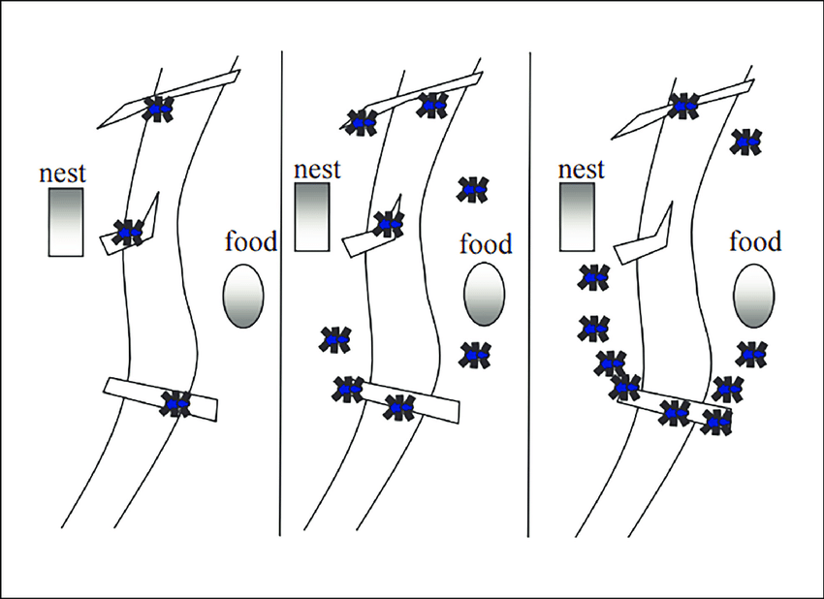
Spatial Cognition
Ant Route Learning: Sequences, not Maps
Ants learn routes through repetition and reward
But they often repeat old motor plans rather than using spatial relations
Reveals limits of habitual route learning
Notes:
Ants are excellent navigators—at least, it seems that way at first glance.
If you train an ant to travel between two points, such as its nest and a food source, it quickly learns the routine.
After a few trials, it can walk a nearly perfect line from A to B, and back again, guided by visual landmarks and chemical trails.
To an observer, it looks as though the ant “knows where it’s going.”
But experiments reveal a very different story.
If you take an ant that has learned this route and place it midway between A and B—right along the familiar path—it will still walk the expected route back to its nest.
However, if you place it in the same location but facing the opposite direction, its behavior changes dramatically.
Even if it’s standing just a few centimeters from home, it will turn and walk away from the nest—toward where the food should be—before turning back and retracing its steps.
The reason is that the ant isn’t representing places at all.
It’s repeating a stored sequence of movements—a chain of egocentric motor commands that worked before.
Its navigation depends on matching the next expected visual pattern or step in the sequence, not on an internal model of how the nest and food are arranged in space.
This kind of route-following is efficient but fragile.
It breaks down if the environment changes, if landmarks are moved, or if the ant starts from an unfamiliar point.
So while it looks like goal-directed navigation, it’s really just habitual behavior—a powerful reminder that learning can occur without true understanding of space.

Slide 10
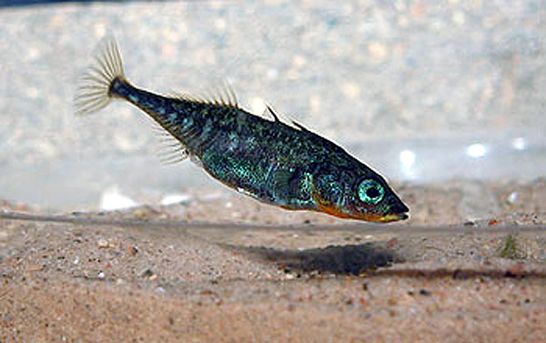
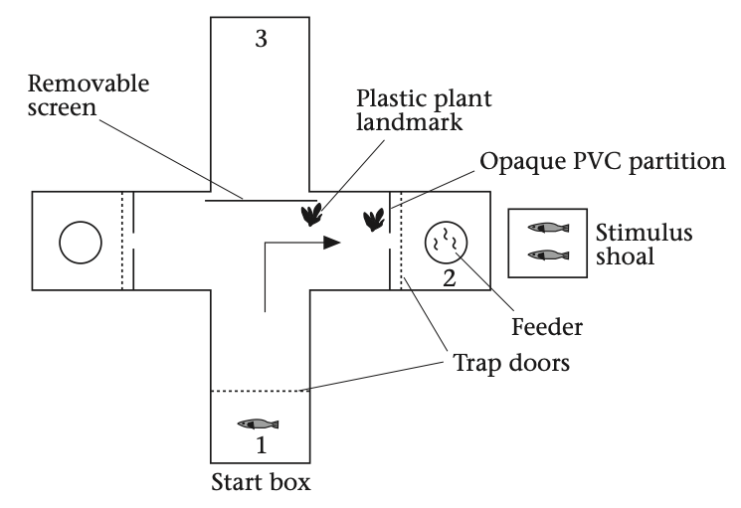
Spatial Cognition
Fish: Learning Locations, Not Movements
Fish learn places, not fixed paths
Doing so requires three linked abilities:
Relational mapping, perceptual invariance, and self-localization
Notes:
We just saw that ants can learn highly reliable routes, but they do so by memorizing movement sequences rather than representing space itself.
Fish, by contrast, can solve navigation problems that demand something more.
In a classic set of experiments, researchers placed small fish in a tank containing a food reward hidden in a small container.
At first, the fish explored randomly until one happened to find the food.
When it was reintroduced later at the same starting position, it found the food much faster—basic learning.
But when it was released from a different starting position, something interesting happened.
The fish didn’t repeat the same pattern of fin strokes or turns.
It swam directly toward the correct location where the food was hidden.
That behavior shows three distinct abilities at work.
First, the fish has learned a relational map of its environment—how landmarks, the container, and the tank boundaries are arranged relative to each other.
This means it encodes structure, not just motor commands.
Second, it must handle perceptual invariance: the world looks different from this new viewpoint, yet the fish recognizes that it’s the same place.
That’s the same invariance problem that visual and auditory systems must solve to identify objects under changing conditions.
Third, the fish estimates its own position within that relational structure.
It must know, roughly, “I’m here; the food is over there.”
That requires integrating sensory feedback from its own motion—a primitive form of self-localization.
These three abilities—mapping relationships, handling invariance, and tracking self-position—together form the foundation of spatial cognition.
They turn movement from a reactive process into one guided by an internal model of the world.

Slide 11
Spatial Cognition
Problem 2: Summary & Key Terms
Challenge: estimating position without visual cues
Two strategies: egocentric routes vs. allocentric maps
Key terms: path integration, dead reckoning, self-localization
Notes:
So far we’ve looked at two very different ways organisms can solve navigation problems.
Ants rely on egocentric learning—a memorized chain of actions linked to a fixed sequence of sensory cues.
It works when the environment is stable but fails when the starting point or viewpoint changes.
Fish, on the other hand, show the beginnings of allocentric learning—a sensitivity to spatial relations among landmarks that stays constant even when perspective changes.
That shift from “do what worked before” to “go where the thing is” marks a major evolutionary step.
To do this, animals need to estimate their own motion and update an internal sense of position as they move.
This process is called path integration or dead reckoning.
It combines cues from balance, proprioception, and optic flow to keep a running estimate of location, even without seeing the goal.
Humans use the same mechanisms when walking in the dark or swimming underwater.
Together these terms—egocentric vs. allocentric, path integration, and self-localization—capture a deep idea:
that navigation can be guided either by surface regularities in experience or by an internal model of space itself.
Once those internal models exist, they can be used not just to find things, but to plan, predict, and imagine routes that have never been taken before.
That brings us to the next challenge: building and updating maps of the world.

Slide 12
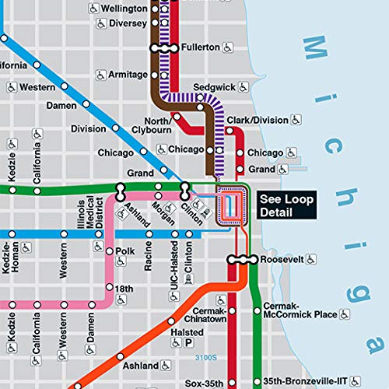
Spatial Cognition
Problem 3: Latent Learning and the Hidden Map
We can learn about space without reward or repetition
Exploration builds knowledge that later guides behavior
Suggests an internal “map” that exists before it’s needed
Notes:
So far, we’ve seen how organisms can learn routes and even track their own position as they move.
But there’s another, deeper puzzle: what if learning about space can happen without immediate reward or reinforcement?
Imagine walking through a new building for the first time, maybe exploring a museum or a friend’s house.
You’re not trying to reach any particular goal—you’re just looking around.
Later, when someone asks you where the exit is, you can point in the right direction, or even find your way there quickly, despite never having practiced that path before.
That ability seems almost trivial, but it challenges the idea that learning requires explicit feedback.
Psychologists call this latent learning—knowledge that’s acquired passively, without reinforcement, and only revealed later when a situation demands it.
From a reinforcement learning perspective, this is puzzling: if no reward or punishment shaped the behavior, how was anything learned at all?
The phenomenon implies that organisms aren’t just memorizing successful sequences; they’re building internal representations of their environment even when no external feedback tells them to.
In other words, exploration itself—without clear goals—can build the kind of model that later enables flexible, goal-directed navigation.
This insight comes from one of the most important experiments in the history of cognitive psychology, conducted by Edward Tolman in the 1940s.

Slide 13
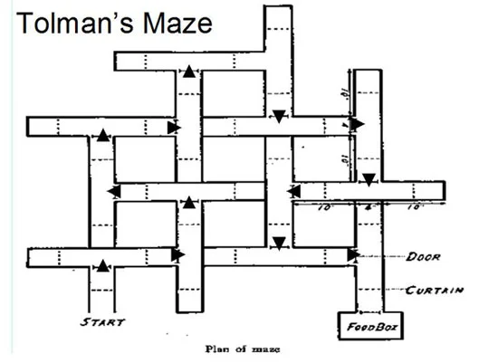
Spatial Cognition
Tolman’s Maze Experiment
Rats explored a maze without reward, then found the goal quickly
Learning occurred before reinforcement
Evidence for an internal “cognitive map”
Notes:
Edward Tolman’s maze experiments were designed to test
whether animals could learn about their environment without reinforcement.
In his setup, rats were placed in a complex maze with many turns and dead ends.
One group received food every time they reached the goal box; another group never received food;
and a third group wandered freely for several days before food was introduced.
According to behaviorist theory at the time, only the first group should have learned
—the one that received consistent reward.
But that’s not what happened.
When the “no reward” group finally received food at the end,
they almost immediately began running the maze as efficiently as the rewarded rats.
Their performance jumped dramatically from one day to the next.
The only reasonable explanation was that they had already learned the layout of the maze during their unrewarded exploration
—they just hadn’t had a reason to demonstrate it yet.
Tolman interpreted this as evidence that the rats had formed an internal cognitive map
—a mental representation of the maze’s structure that could be used flexibly when motivation appeared.
This idea was radical at the time because it suggested that learning involves building models of the world,
not just forming stimulus–response associations.
It also shifted how psychologists thought about curiosity and exploration:
that animals might move around not simply to seek rewards,
but to learn about the structure of their environment in advance,
preparing for future goals that haven’t yet arisen.

Slide 14
Spatial Cognition
Problem 3: Summary and Key Terms
Challenge: learning about space without reward
Latent learning reveals internal “maps” built through exploration
Key terms: cognitive map, model-based learning, intrinsic motivation
Notes:
Tolman’s experiment forced psychologists to rethink what learning even means.
If rats could form accurate expectations about the maze before ever receiving a reward,
then learning must involve more than reinforcement
—it must involve building an internal model of the environment itself.
That internal model is what Tolman called a cognitive map
—a representation of spatial relationships that allows flexible navigation and inference.
Unlike route-following, it can support shortcuts, detours, and novel paths,
because the animal understands how locations relate to one another.
This kind of learning is sometimes described as model-based learning.
Instead of merely storing the value of each action, the organism builds a model of how the world works
—how states lead to other states—and then plans behavior using that model.
It’s the difference between knowing “this action leads to food”
and knowing “the food is over there, so this action will take me toward it.”
Importantly, Tolman’s work also hinted at intrinsic motivation:
animals explore even without obvious rewards because exploration itself is valuable.
It builds knowledge that can later be used to solve problems more efficiently.
So by the mid-20th century, psychologists began to see spatial cognition as more than just movement or reinforcement
—it was about constructing internal structure.
The next challenge, both in biology and machine learning, would be to explain why exploration happens at all,
and how curiosity guides it when reinforcement alone is silent.

Slide 15
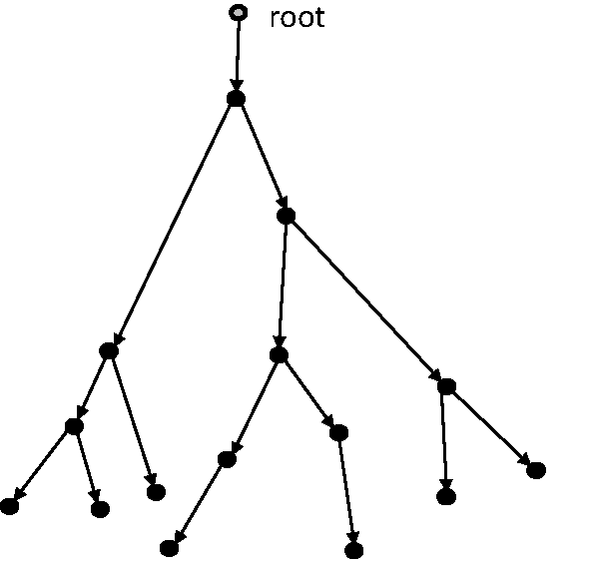
Spatial Cognition
Problem 4: The Exploration Problem
We can stick with what we know—or try something new
Exploration finds information; exploitation secures reward
Curiosity helps balance the two
-3
+8
-7
+9
+7
-5
+2
Notes:
Imagine you’re traveling in a city you don’t know very well, looking for a place to eat.
You could go back to the café you liked yesterday—safe, predictable, satisfying.
Or you could wander a few more blocks to see what else is out there.
The first choice is exploitation—using what you already know to maximize reward.
The second is exploration—trading certainty for the chance to discover something better.
We make decisions like this constantly: whether to try a new study strategy, take a new route home, or talk to someone new in class.
Sometimes exploration pays off; sometimes it doesn’t.
But without it, we never learn enough to adapt when circumstances change.
Biologically, this balance is fundamental.
Organisms that only exploit miss new food sources or fail to adapt when conditions shift.
Those that explore too much waste energy and expose themselves to danger.
Evolution, and later the brain, had to find mechanisms to strike the right balance between learning and earning.
In psychology and neuroscience, this tension is captured by the exploration–exploitation tradeoff.
And when reinforcement signals are sparse or absent, another force takes over: curiosity—the intrinsic motivation to gather information just for its own sake.
Curiosity sustains learning when the environment is uncertain, pushing organisms—and people—to map the world more deeply, even when the rewards aren’t obvious yet.

Slide 16
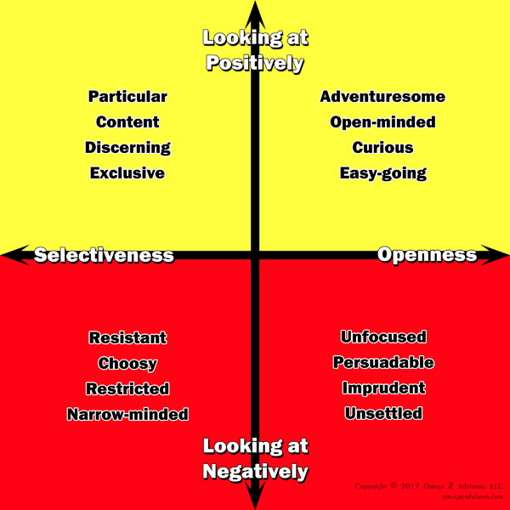
Spatial Cognition
Exploration and Exploitation in Everyday Life
The explore–exploit tradeoff appears everywhere
From foraging and learning to relationships and creativity
Exploration builds models; exploitation applies them
Notes:
The tension between exploration and exploitation isn’t limited to choosing restaurants—it’s everywhere in behavior.
A foraging bird faces the same decision: should it keep searching for berries on this tree or move to a new one?
A student wonders whether to keep using a familiar study method or try something different.
Even in relationships, people balance the comfort of stability with the desire to explore new social or romantic possibilities.
Across all these settings, the tradeoff has the same logic.
Exploration expands what you know; exploitation uses what you already know to get results.
Early in learning, exploration dominates—you try many strategies, sample different options, and gather data.
As knowledge accumulates, exploitation becomes more efficient—you rely on proven patterns.
But the key insight is that exploration and exploitation are not opposites—they’re stages in a cycle.
Exploration builds internal models of the world: what works, where things are, what patterns matter.
Exploitation applies those models to achieve goals efficiently.
Too much of either creates problems
—too little exploration leads to rigidity, too little exploitation leads to aimless searching.
In both animals and humans, this balance is shaped by uncertainty.
When the environment is unpredictable, exploration increases.
When it becomes familiar and stable, exploitation takes over.
Understanding how organisms and brains manage this balance gives us insight into curiosity,
learning, and even creativity itself.

Slide 17
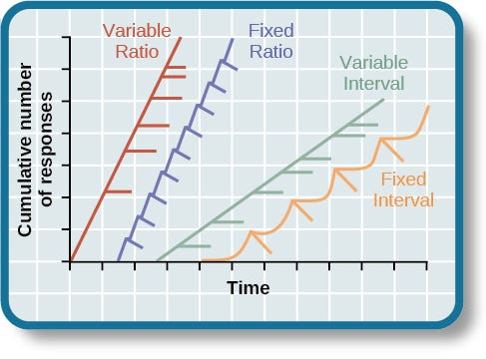
Spatial Cognition
Gambling, Uncertainty, and Variable Rewards
Uncertainty keeps behavior going
Variable rewards strengthen exploration
The same principle drives both learning and addiction
Notes:
One of the most striking demonstrations of the exploration–exploitation dynamic comes from gambling.
Slot machines, for instance, are designed around variable ratio reinforcement—the same principle B. F. Skinner studied in pigeons.
In a variable ratio schedule, rewards come unpredictably: sometimes right away, sometimes after many tries.
That uncertainty makes behavior incredibly persistent, because each new action might be the one that pays off.
Skinner found that pigeons pecking for food under a variable ratio schedule would continue almost indefinitely, even when rewards became rare.
The pattern mimics what happens in casinos or online games: the irregular reward keeps players exploring, hoping the next trial will be the lucky one.
This isn’t just habit—it’s a form of learning tuned by uncertainty itself.
In the brain, variable rewards engage dopaminergic systems linked to both reinforcement and curiosity.
Dopamine spikes don’t just track pleasure—they signal prediction error: the gap between expected and received outcome.
Every time something surprising happens, the brain updates its model of the world, strengthening exploratory behavior.
This same mechanism that makes gambling addictive is also what makes learning adaptive.
Intermittent, uncertain rewards keep us engaged, pushing us to gather more information and test new possibilities.
It’s the biological bridge between curiosity and compulsion—between exploration that helps us learn and exploration that can spiral out of control.

Slide 18
Spatial Cognition
Problem 4: Summary and Key Terms
Challenge: balancing exploration and exploitation
Curiosity motivates learning when rewards are uncertain
Key terms: exploration–exploitation tradeoff, variable ratio reinforcement, prediction error
Notes:
Let’s step back and summarize what this last problem was about.
Organisms and humans constantly face a choice between exploration—seeking new information—and exploitation—using what they already know to gain reward.
Finding the right balance is one of the central challenges of learning, both in nature and in artificial intelligence.
We saw that curiosity helps bridge this gap.
It drives behavior even when rewards are absent or uncertain, keeping learning going and encouraging organisms to build richer models of the world.
That’s what Tolman’s rats were doing—exploring first, then exploiting what they had learned when food appeared.
Behaviorists like Skinner later showed that uncertainty itself can be rewarding.
Under variable ratio reinforcement, as in gambling, unpredictable rewards sustain high levels of activity.
Every surprising outcome triggers a small burst of learning, powered by prediction error—the difference between what was expected and what actually happened.
Together these principles reveal that exploration isn’t random—it’s guided by mechanisms that make novelty intrinsically interesting and uncertainty intrinsically motivating.
That motivation to learn for its own sake paved the way for more complex behaviors, including the ability to use maps to plan new routes or anticipate unseen outcomes.
The next step is to see what all these partial solutions—stabilizing perception, tracking position, building maps, and exploring for curiosity’s sake—add up to in evolutionary and functional terms.

Slide 19
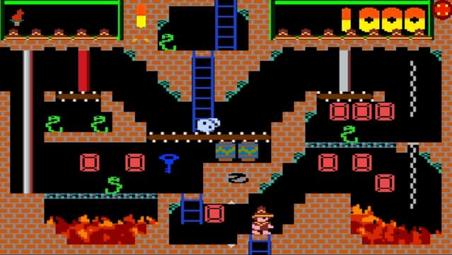
Spatial Cognition
The Limits of Reinforcement and Pattern Recognition
Reflexes, Hebbian learning, and RL enable adaptive behavior
But they depend on past experience, not internal structure
True navigation requires representing unseen relations
Notes:
Let’s take stock of how far we’ve come.
Early organisms could orient toward or away from signals—simple reflexes tuned by evolution.
Hebbian learning added the ability to strengthen useful associations, linking stimuli and actions through experience.
Pattern recognition expanded that further, letting organisms generalize across similar situations.
And reinforcement learning made it possible to chain actions across time, connecting behavior to delayed outcomes.
Each of these systems made behavior more flexible.
But all of them share a common limitation: they depend on past experience.
They can only repeat or recombine what has already worked before.
They can’t, by themselves, represent unseen relationships or imagine outcomes that haven’t yet occurred.
That’s fine when the world is stable and feedback is immediate.
But in a complex, changing environment—where rewards are distant or hidden—these systems start to fail.
An animal needs more than the memory of what worked; it needs a way to model how the world is structured and why actions lead to particular results.
True navigation—whether through physical space or abstract problem space—requires representing unseen relations:
the locations of objects not currently perceived, the consequences of movements not yet made, and the stable structure of an environment that keeps changing around you.
Spatial mapping, curiosity, and prediction emerge as solutions to these deeper limitations—mechanisms that let organisms move from reactive learning to genuinely model-based behavior.

Slide 20
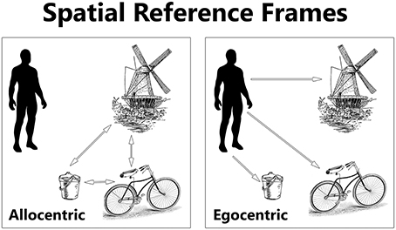
Spatial Cognition
The Benefits of Spatial Mapping and Exploration
Spatial maps enable detours, shortcuts, and flexible plans
Curiosity expands those maps beyond immediate goals
Together they transform learning from reactive to predictive
Notes:
Once an organism can represent space, a whole new world of possibilities opens up.
A spatial map allows it to take detours around obstacles, to find shortcuts to goals, and to maintain orientation even when sensory cues are missing.
Instead of following fixed routines, it can now make choices based on the structure of the environment.
Curiosity makes those maps even richer.
When exploration is intrinsically rewarding, an animal gathers information about places and relationships that aren’t immediately useful.
Later, that information can be repurposed for new goals—finding food when supplies shift, escaping predators, or remembering where resources were hidden.
Curiosity transforms movement from mere reaction into a kind of ongoing world-building process.
Together, spatial mapping and curiosity shift behavior from reactive to predictive.
Instead of waiting for feedback, the organism can simulate outcomes, anticipate what might happen next, and act proactively.
Evolutionarily, this was an enormous leap: a way to use internal structure to guide future behavior rather than relying only on past reward.
From a cognitive perspective, it’s the bridge between perception and planning, and from a neural perspective, it sets the stage for hippocampal and cortical systems that integrate space, memory, and imagination.
In short, once you have a map—and a motive to expand it—you’ve entered the era of genuine cognition.

Slide 21
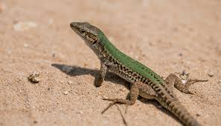
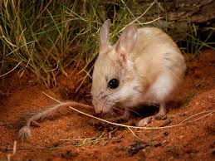
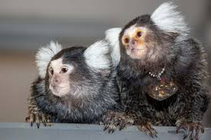
Spatial Cognition
Evolutionary Continuity and Ecological Payoffs
Spatial systems are conserved across vertebrates
Maps improve foraging, homing, and territory use
Internal models make behavior more efficient and flexible
Notes:
These abilities didn’t evolve just once—they’re deeply conserved across vertebrates.
From fish to birds to mammals, we find similar spatial systems organizing movement and memory.
The same core circuitry—especially in the hippocampal and parahippocampal regions—supports navigation, orientation, and even the mental simulation of routes.
In ecological terms, the advantages are enormous.
A species that can represent space internally doesn’t need to rediscover routes each time—it can take shortcuts, avoid hazards, and exploit resources more efficiently.
Birds use cognitive maps to migrate and return to their nests year after year; mammals use them to navigate complex territories and remember the locations of food caches or dens.
Even in simpler vertebrates like fish and amphibians, spatial learning improves foraging success and predator avoidance.
Rather than wandering randomly, they can use internal representations to make purposeful, informed choices about where to move next.
This continuity suggests that spatial cognition is one of the fundamental architectures of intelligence—a set of conserved mechanisms that nature kept and elaborated upon rather than reinventing.
It’s a solution to the same general problem: how to stay oriented, plan actions, and make predictions in a world where information is always incomplete.
By the time mammals appear, those same systems are doing more than spatial navigation—they’re organizing memory and imagination as well.
Understanding how they evolved helps explain why so many cognitive capacities, from foraging to thinking, still depend on the same underlying neural machinery.

Slide 22
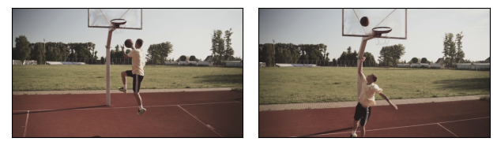
Spatial Cognition
Functional Summary: From Reacting to Predicting
Early learning systems reacted to immediate outcomes
Spatial mapping added structure and foresight
Prediction turned behavior from reactive to proactive
Notes:
When we step back, we can see a clear functional story emerging.
Early learning systems—reflexes, Hebbian associations, and reinforcement learning—were essentially reactive.
They adjusted behavior based on past outcomes, but couldn’t anticipate what lay ahead.
Each improvement made behavior a little more flexible, but still tied to immediate experience.
Spatial cognition changed that.
By introducing internal structure—representations of relations, distances, and directions—organisms could now simulate outcomes before acting.
Instead of “if this, then that,” they could think, in effect, “if I go this way, I’ll end up there.”
That capacity for prediction—for modeling the consequences of future movement—marks a fundamental shift in what brains do.
Curiosity and exploration reinforced the same trend.
They filled in gaps in those internal models, making them more complete and adaptable.
Over evolutionary time, this transition—from reacting to predicting—allowed animals to forage efficiently, plan detours, anticipate threats, and exploit opportunities that hadn’t yet appeared.
At a broader level, prediction is what turns learning into cognition.
It’s the capacity to use internal structure to guide future action rather than relying solely on feedback from the past.
Spatial maps were the first large-scale predictive models the brain ever built, and they became the template for more abstract forms of thinking that evolved later.

Slide 23
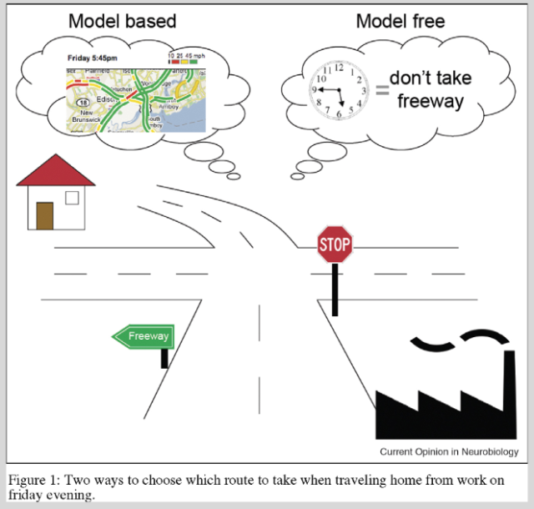
Spatial Cognition
Bridging to Computation: Spatial Maps as Model-Based Learning
Cognitive maps anticipate outcomes, not just actions
Model-based systems use internal structure to plan
The same principles appear in brains and algorithms
Notes:
The spatial systems we’ve been talking about don’t just record experience—they use it to predict.
That predictive capacity is what makes them powerful,
and it’s what connects biological navigation to computational models of learning.
In Tolman’s sense, a cognitive map is a representation that encodes relationships among states
—places, cues, and actions—so that the organism can infer new paths and outcomes.
When an animal takes a shortcut it’s never traveled before,
it’s using that internal model to simulate possibilities.
That’s exactly what model-based reinforcement learning does in modern AI systems.
In a model-free learner, behavior is guided only by the history of reward
—just like early animals relying on habit or simple reinforcement.
In a model-based learner, the agent builds
an internal structure describing how actions change the state of the world,
and then plans by mentally exploring that structure.
In both cases, prediction replaces reaction as the main driver of behavior.
Neuroscience tells the same story.
The hippocampus and connected cortical systems don’t just encode “where things are”
—they represent transitions, expectations, and alternative routes.
When animals, or people, imagine moving through space
—or even through abstract problem spaces—these same spatial circuits light up.
So the bridge between biology and computation runs right through spatial cognition.
The first brains to build maps were, in a sense, the first predictive machines
—and the foundations of modern model-based learning
were already being laid hundreds of millions of years ago.

Slide 24
Spatial Cognition and Curiosity
Recap
Spatial cognition and the evolution of internal models
Curiosity as a way to fill out the model
Up Next
Algorithms and representations for mapping, planning, and exploration
Notes:
Last time, we looked at how reinforcement learning made behavior more adaptive—how organisms learned to connect actions with outcomes across time, and to adjust to changing conditions.
That gave us a picture of how simple feedback-driven systems can learn effectively from experience.
Today, we added a new layer to that story.
We saw how movement itself created new problems—how organisms needed to stabilize perception, estimate their own motion, and eventually build internal maps of space.
Through examples from ants, fish, and Tolman’s rats, we traced how navigation evolved from sequences of reflexes into flexible, model-based behavior.
And we saw how curiosity and exploration became intrinsic drives, keeping learning going even in the absence of immediate rewards.
Together, these developments mark a turning point in cognitive evolution.
Once organisms could represent the structure of their environments and predict what would happen next, learning became proactive rather than reactive.
Spatial cognition was the first major step toward using internal models of the world—an idea that connects directly to both cognitive psychology and modern artificial intelligence.
Next time, we’ll move from function to algorithm.
We’ll look at how these abilities can be formalized—how spatial maps, path integration, and curiosity can be modeled computationally, and how the same ideas appear in reinforcement learning agents and neural networks.
In other words, we’ll see how brains and machines both learn to map, plan, and explore.

